Slide 1
Generating Mechanistic-Empirical Traffic Data
Peter Kemp, PE
Pavement Unit Supervisor
September 2023

Slide 2

Weigh-in-Motion (WIM) Sites
Urban/Rural | Functional Class | Truck Percent | AADT | WIM Station
Urban | Principal Arterial | 2.76 | 28039 | Station #1
Urban | Principal Arterial | 3.24 | 13046 | Station #2
Rural | Minor Arterial | 8.42 | 10154 | Station #3
Rural | Minor Arterial | 10.7 | 2080 | Station #4
Urban | Principal Arterial | 11.09 | 5002 | Station #5
Rural | Minor Arterial | 11.21 | 2080 | Station #6
Rural | Minor Arterial | 11.36 | 5000 | Station #7
Rural | Minor Arterial | 12.64 | 4393 | Station #8
Urban | Interstate/Freeway | 13.33 | 76603 | Station #9
Rural | Principal Arterial | 19.25 | 10652 | Station #10
Rural | Interstate/Freeway | 22.51 | 10301 | Station #11
Rural | Interstate/Freeway | 23.04 | 14500 | Station #12
Rural | Interstate/Freeway | 24.2 | 17614 | Station #13
Rural | Interstate/Freeway | 25.51 | 54668 | Station #14
Rural | Interstate/Freeway | 25.55 | 56016 | Station #15
Rural | Principal Arterial | 26.53 | 8902 | Station #16
Urban | Interstate/Freeway | 30.17 | 29096 | Station #17
Functional Class | Number of WIM Stations
Interstate | 7
Rural | 5
Urban | 2
Minor Arterial | 5
Rural | 5
Urban | 0
Principal Arterial | 5
Rural | 2
Urban | 3
Total | 17
Notes:
As we all are well aware of that there are many input in PMED one of the more important or impactful ones is Traffic . Historically Wisconsin has typically used 5 AASHTO traffic classes as inputs to fulfill the traffic requirements for our local based software WisPave. WisPave uses AASHTO 72 as the basis of this design. So this does not work for PMED. To best represent traffic inputs for PMED we would like to use a level one input, not the national averages. This is not currently possible as it takes a Weigh in Moition WIM station to do so. These are expensive to install and maintain
2D, 3SU, 2S-1 and 2S-2, 3S-2, 2-S1 and 2S-2 (AASHTO) for WisPave. https://wisconsindot.gov/rdwy/fdm/fd-14-07.pdf#fd14-7

Slide 3
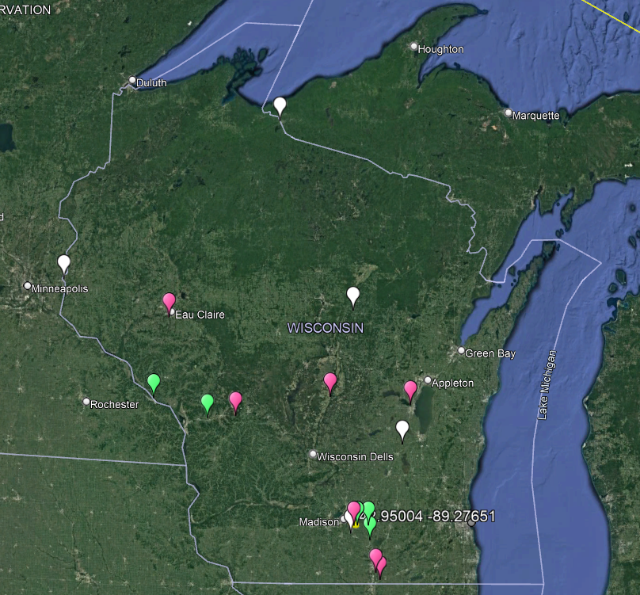
Weigh-in-Motion (WIM) Sites
Functional Class | Number of WIM Stations
Interstate | 7
Rural | 5
Urban | 2
Minor Arterial | 5
Rural | 5
Urban | 0
Principal Arterial | 5
Rural | 2
Urban | 3
Total | 17
Notes:
So how do we best make use of the resources we currently have? To best make use of the WIM station data we do have a tool was developed by a colleague and former WisDOT employee, Ali Morovatdar. This was to give the department a tool to generate a hybrid traffic to best represent the traffic inputs for PMED. At the time this tool was developed 17 WIM stations were available The majority being on the interstate.

Slide 4
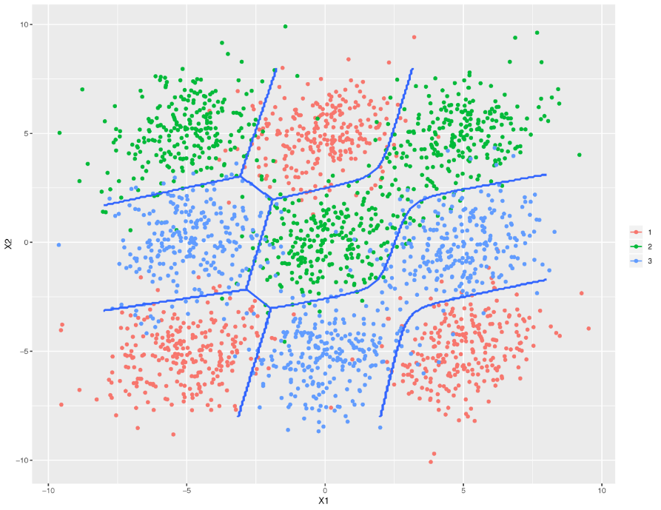
Fisher Linear Discriminant Analysis (LDA)
LDA: A method used in statistics to find a linear combination of features that characterizes or separates two or more classes of objects or events. The resulting combination may be used as a linear classifier.
Generate ME traffic data based on prominent features:
  Functional class
  Urban/rural
  AADT
  Truck percentage
Notes:
There are two types of clustering techniques that can be used to classify data supervised and unsupervised. This is a supervised method called Fisher Linear Discriminant Analysis.

Slide 5
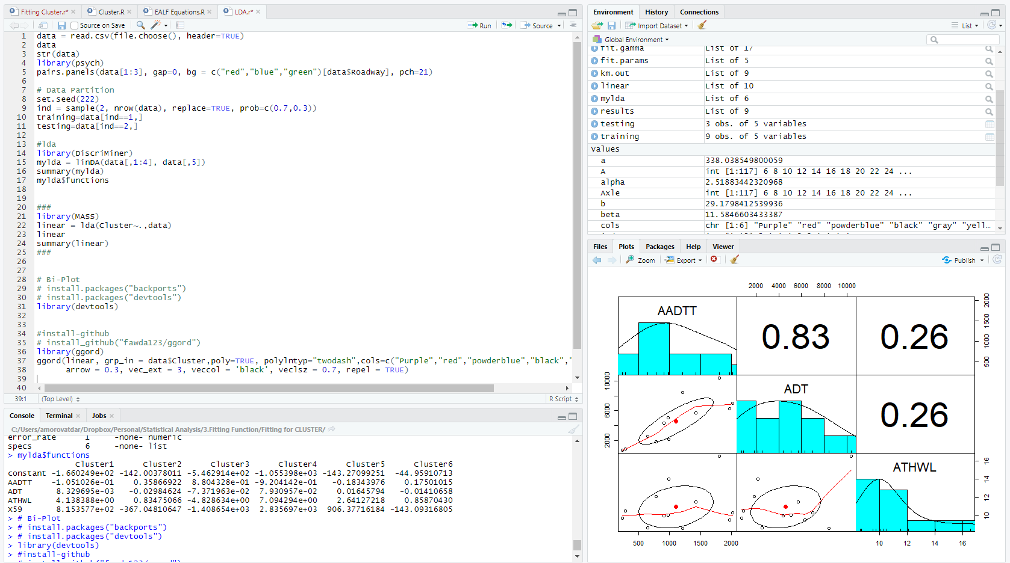
Fisher Linear Discriminant Analysis (LDA)
Perform linear discriminant analysis using R
Calculate the Fisher’s linear discriminant coefficients for different WIM Stations.
LDA Coefficients | Station #1 | Station #2 | Station #3 | Station #4 | Station #5 | Station #6 | Station #7 | Station #8 | Station #9 | Station #10 | Station #11 | Station #12 | Station #13 | Station #14 | Station #15 | Station #16 | Station #17
$$α$$ | 0.0025 | 0.0008 | -0.0007 | -0.0021 | -0.0020 | -0.0023 | -0.0021 | -0.0025 | 0.0056 | -0.0032 | -0.0040 | -0.0037 | -0.0036 | 0.0004 | 0.0005 | -0.0051 | -0.0037
$$β$$ | -3.2327 | 0.6790 | 7.6004 | 12.1636 | 12.1890 | 12.9873 | 12.7289 | 14.5129 | -1.9400 | 20.5000 | 24.5000 | 24.5000 | 24.9000 | 17.7000 | 17.4000 | 29.8000 | 29.8000
$$γ$$ | -34.2458 | -9.1924 | -30.9730 | -65.4440 | -66.2837 | -74.1749 | -71.9658 | -92.1625 | -212.0000 | -184.0000 | -260.0000 | -263.5000 | -275.0000 | -241.5000 | -241.0000 | -378.0000 | -406.0000
Notes:
The FLDA based on the classifications and sorting give coefficients, alpha , beta , gama to the individual stations.

Slide 6
Fisher Linear Discriminant Analysis (LDA)
Calculation of discriminant (classification) scores
Identify WIM station with the highest discriminant score
$$Discriminant Score=α\left(AADT\right)+β\left(Truck Percent\right)+γ$$
LDA Coefficients | Station #1 | Station #2 | Station #3 | Station #4 | Station #5 | Station #6 | Station #7 | Station #8 | Station #9 | Station #10 | Station #11 | Station #12 | Station #13 | Station #14 | Station #15 | Station #16 | Station #17
$$α$$ | 0.0025 | 0.0008 | -0.0007 | -0.0021 | -0.0020 | -0.0023 | -0.0021 | -0.0025 | 0.0056 | -0.0032 | -0.0040 | -0.0037 | -0.0036 | 0.0004 | 0.0005 | -0.0051 | -0.0037
$$β$$ | -3.2327 | 0.6790 | 7.6004 | 12.1636 | 12.1890 | 12.9873 | 12.7289 | 14.5129 | -1.9400 | 20.5000 | 24.5000 | 24.5000 | 24.9000 | 17.7000 | 17.4000 | 29.8000 | 29.8000
$$γ$$ | -34.2458 | -9.1924 | -30.9730 | -65.4440 | -66.2837 | -74.1749 | -71.9658 | -92.1625 | -212.0000 | -184.0000 | -260.0000 | -263.5000 | -275.0000 | -241.5000 | -241.0000 | -378.0000 | -406.0000
Notes:
Based on the users input a discriminate score is given to each station using the alpha, beta and gamma coefficients calculated in the FLDA. The highest score based on this calculation is chosen to best represent the input traffic paraments of functional classification , AADT, and truck percentage.

Slide 7
Verification of the LDA Results
Urban/Rural | Functional Class | Truck Percent | AADT | WIM Station |  | Discriminant Score
Urban/Rural | Functional Class | Truck Percent | AADT | WIM Station |  | Station #1 | Station #2 | Station #3 | Station #4 | Station #5 | Station #6 | Station #7 | Station #8 | Station #9 | Station #10 | Station #11 | Station #12 | Station #13 | Station #14 | Station #15 | Station #16 | Station #17
Urban | Principal Arterial | 2.76 | 28039 | Station #1 |  | 27.39825 | 14.44365 | -30.8063 | -91.1435 | -88.2576 | -101.911 | -95.2378 | -121.525 | -59.6112 | -217.494 | -304.176 | -299.875 | -305.723 | -182.501 | -178.673 | -439.031 | -428.216
Urban | Principal Arterial | 3.24 | 13046 | Station #2 |  | -11.8866 | 14.44365 | -30.8063 | -91.1435 | -88.2576 | -101.911 | -95.2378 | -121.525 | -59.6112 | -217.494 | -304.176 | -299.875 | -305.723 | -182.501 | -178.673 | -439.031 | -428.216
Rural | Minor Arterial | 8.42 | 10154 | Station #3 |  | -35.9103 | 4.405789 | 25.4863 | 15.50899 | 16.20734 | 12.15278 | 14.06127 | 4.897118 | -171.382 | -43.9716 | -93.9027 | -94.6905 | -101.078 | -88.6705 | -88.9866 | -179.474 | -193.029
Rural | Minor Arterial | 10.7 | 2080 | Station #4 |  | -63.6008 | -0.31253 | 48.80775 | 60.30938 | 60.01317 | 60.0723 | 59.90089 | 57.97603 | -221.305 | 28.71176 | -5.72847 | -8.81421 | -15.542 | -51.1924 | -53.2889 | -70.4883 | -95.0538
Urban | Principal Arterial | 11.09 | 5002 | Station #5 |  | -57.5077 | 2.220146 | 49.60322 | 58.87643 | 58.97107 | 58.51143 | 58.77879 | 56.40183 | -205.601 | 27.36575 | -7.82274 | -10.0746 | -16.2507 | -43.2013 | -45.0522 | -73.7657 | -94.3053
Rural | Minor Arterial | 11.21 | 2080 | Station #6 |  | -65.2494 | 0.033769 | 52.68397 | 66.51281 | 66.22957 | 66.6958 | 66.39263 | 65.37762 | -222.297 | 39.1869 | 6.785549 | 3.700766 | -2.84716 | -42.1459 | -44.4097 | -55.3098 | -79.858
Rural | Minor Arterial | 11.36 | 5000 | Station #7 |  | -58.3855 | 2.401931 | 51.65682 | 62.16482 | 62.02253 | 62.02253 | 62.26608 | 60.32527 | -206.137 | 32.91782 | -1.18969 | -3.44162 | -9.52281 | -38.4127 | -40.3525 | -65.7198 | -86.253
Rural | Minor Arterial | 12.64 | 4393 | Station #8 |  | -64.051 | 2.799969 | 61.83587 | 79.01732 | 79.07202 | 80.02266 | 79.7771 | 80.40459 | -212.046 | 61.152 | 32.64103 | 30.21841 | 24.50256 | -15.9305 | -18.368 | -24.5327 | -45.8561
Urban | Interstate/Freeway | 13.33 | 76603 | Station #9 |  | 115.4507 | 59.31305 | 13.48619 | -65.2329 | -55.7468 | -74.7589 | -61.8496 | -88.3578 | 193.4537 | -155.896 | -238.671 | -220.503 | -215.741 | 22.82973 | 29.39757 | -371.83 | -293.966
Rural | Principal Arterial | 19.25 | 10652 | Station #10 |  | -69.6669 | 12.14613 | 107.4293 | 146.1878 | 147.2267 | 151.6757 | 150.878 | 160.839 | -189.633 | 176.8763 | 169.8484 | 169.2227 | 166.7248 | 103.6187 | 99.81227 | 140.3099 | 127.8058
Rural | Interstate/Freeway | 22.51 | 10301 | Station #11 |  | -81.0888 | 14.08733 | 132.4671 | 186.583 | 187.6591 | 194.8101 | 193.1053 | 209.0201 | -197.949 | 244.9589 | 251.2411 | 250.5214 | 249.1233 | 161.3168 | 156.3957 | 239.1214 | 226.2457
Rural | Interstate/Freeway | 23.04 | 14500 | Station #12 |  | -72.2345 | 17.7062 | 133.3789 | 184.1535 | 185.7905 | 192.1718 | 191.1054 | 206.3161 | -175.322 | 242.3994 | 247.4846 | 247.9631 | 247.3471 | 172.2603 | 167.7021 | 233.5057 | 226.4144
Rural | Interstate/Freeway | 24.2 | 17614 | Station #13 |  | -68.1473 | 20.91074 | 139.8842 | 191.6806 | 193.7531 | 200.1757 | 199.3846 | 215.4415 | -160.033 | 256.254 | 263.5177 | 264.8862 | 265.1205 | 193.9805 | 189.4397 | 252.1669 | 249.3912
Rural | Interstate/Freeway | 25.51 | 54668 | Station #14 |  | 20.87234 | 50.55909 | 122.3394 | 129.2873 | 136.2238 | 133.1657 | 138.8779 | 142.7158 | 46.18743 | 164.5118 | 147.7522 | 159.6883 | 165.6362 | 230.8267 | 230.5931 | 102.4041 | 150.5581
Rural | Interstate/Freeway | 25.55 | 56016 | Station #15 |  | 24.13557 | 51.63248 | 121.6429 | 126.9244 | 134.0376 | 130.6285 | 136.5793 | 139.9589 | 53.70447 | 161.017 | 143.3529 | 155.6734 | 161.8264 | 161.8264 | 232.0313 | 96.72797 | 146.7345
Rural | Principal Arterial | 26.53 | 8902 | Station #16 |  | -97.6051 | 15.7312 | 164.0592 | 238.4379 | 239.4339 | 250.1913 | 247.1896 | 270.8256 | -213.648 | 332.0073 | 355.4655 | 354.3543 | 354.1755 | 232.1112 | 225.6919 | 365.8903 | 351.2296
Urban | Interstate/Freeway | 30.17 | 29096 | Station #17 |  | -58.5495 | 33.87607 | 176.7368 | 240.0256 | 243.7469 | 251.6732 | 251.4597 | 273.6567 | -106.949 | 342.1087 | 364.1724 | 368.8259 | 372.7927 | 304.0955 | 299.0634 | 371.3563 | 384.5509
Notes:
This is a representation of results of the supporting this selection. You can see that based on the FDLA coefficients and the inputs of Urban or Rural, Functional Class, AADT and truck percentage a discriminate score is calculated for each site. What you are looking for is the highest score which is highlighted. So this is just showing the accuracy of the tool.

Slide 8
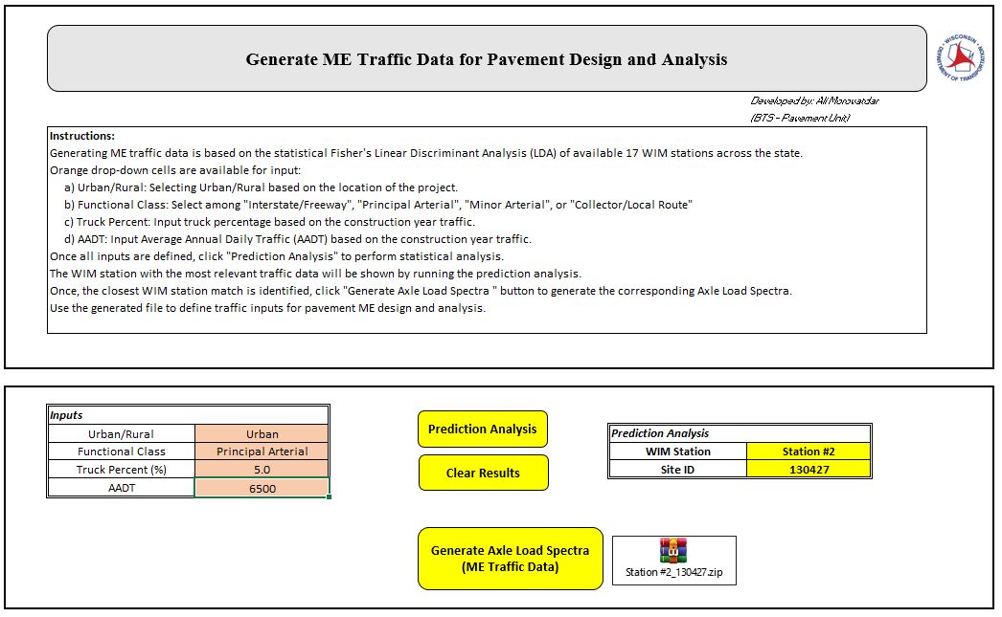
Pavement ME Traffic Data Generator

Slide 9
Pavement ME Traffic Data Generator
Notes:
A xml table is provided for traffic inputs based on the analysis. FLDA

Slide 10
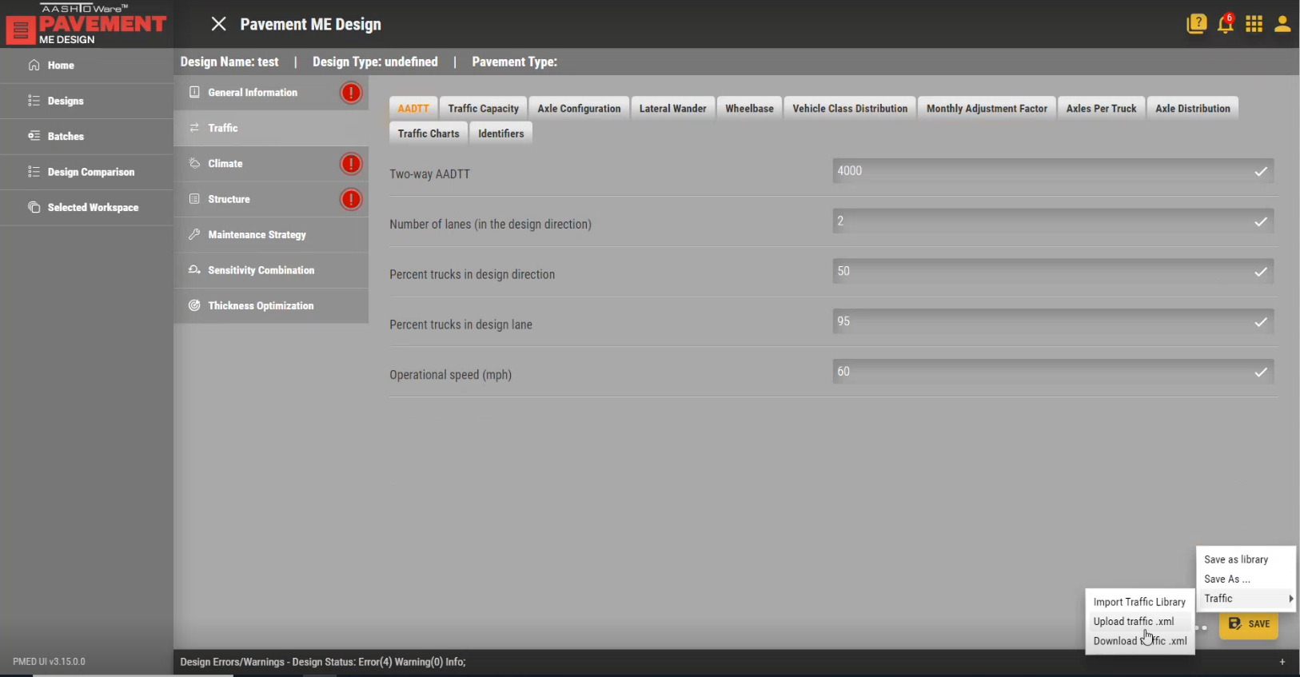
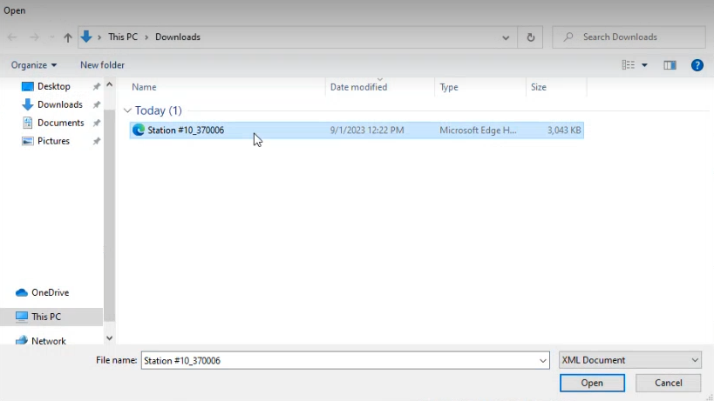
Pavement ME Design
Notes:
This is inputted directly into PMED

Slide 11
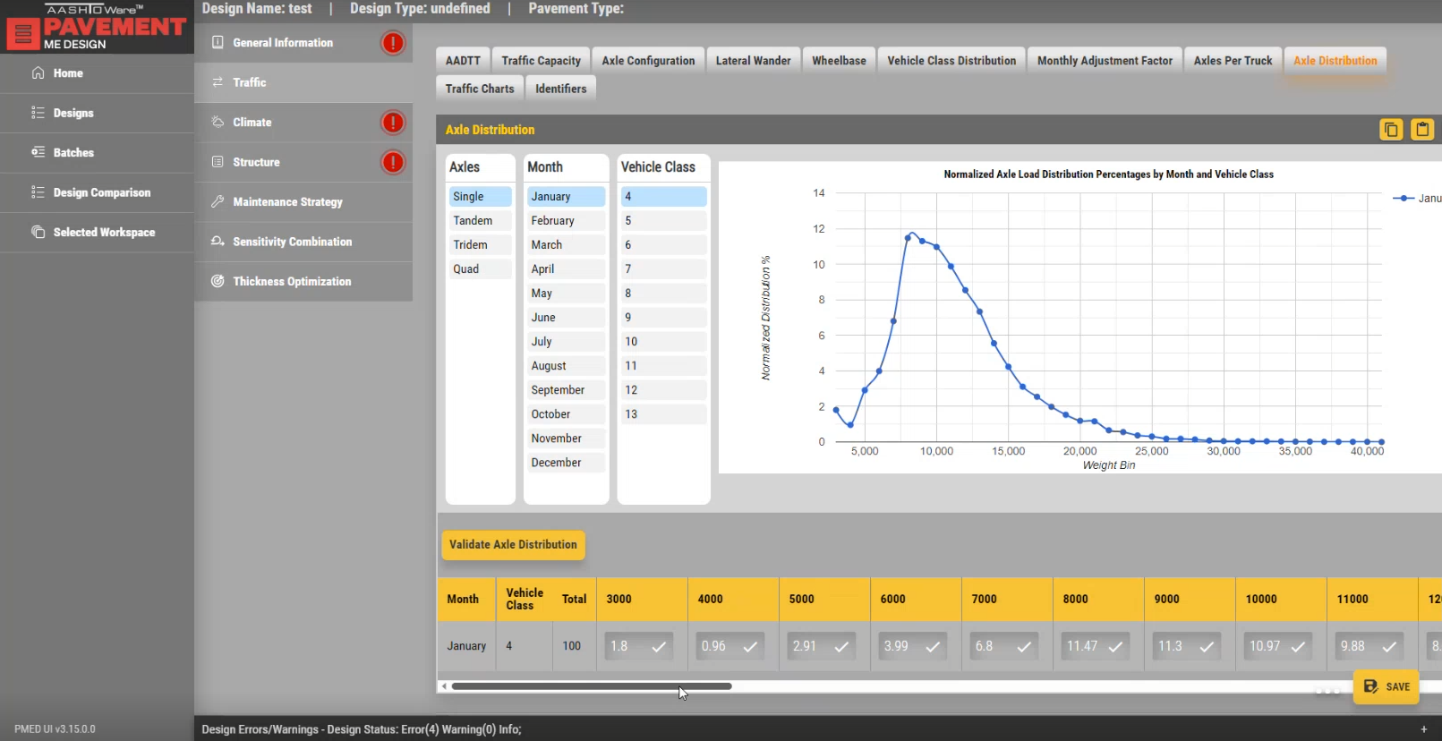
Pavement ME Design
Notes:
Axle load distribution for all the axles, months and vehicle classes.

Slide 12

Discussion

